Slide 1
Dynamic URLs in Django
Dr. Navneet Kaur

Slide 2
Types of URLs
Static
http://localhost:8000/products
Dynamic
http://localhost:8000/products/123
http://localhost:8000/products?q=query

Slide 3
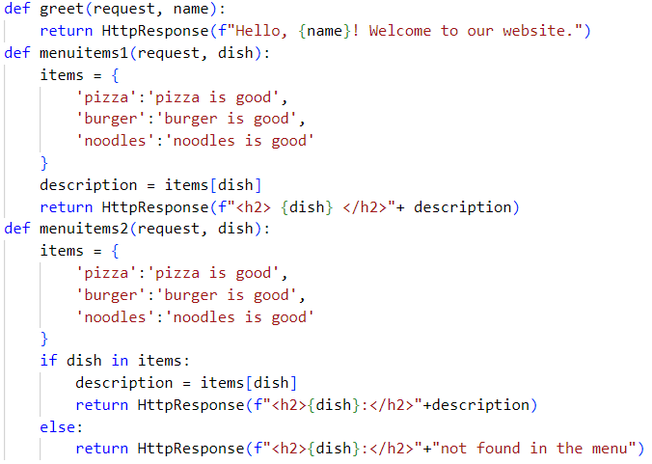
Dynamic URLs using route parameter
views.py

Slide 4


Dynamic URLs using route parameter
urls.py

Slide 5
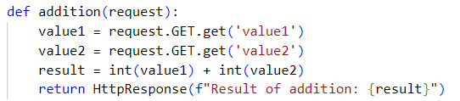
Dynamic URLs using query string
views.py

Slide 6
Dynamic URLs using query string
urls.py

